Slide 1
Can Minimum Wages Cause a Big Push? Evidence from Indonesia
Jeremy Magruder
JDE 2013

Slide 2
Requiring rise in minimum wage could be a means of obtaining the two alternative equilibria in Murphy et al
If too high, wage rate increase could cause losses in profits and low level equilibrium, but if not too high, an increase in the minimum wages could induce firms to industrialize with capital and achieve the higher productivity by vast majority of firms, boosting demand for local production.
Henry Ford example of doubling wages in Detroit in1914

Slide 3
Indonesia of early 1990s when minimum wages were increased
Pressure from US, and anti sweatshop since garments exports were important and ILO which said that minimum wage increases could raise subsistence consumption
Tripartite setting of these minimums by government, employers and workers . They doubled in real terms 1990-97 but then fell after the 1997 Asian financial crisis. Different in different districts, highest in Jakarta
Some existing studies using diff and diff showed that these lowered employment . But this method does not control for unobserved differences between districts. Trpartite commissions may have considered these in setting the differenct increases in minimum wage, such as in cost of living.

Slide 4
Alternative Estimation
1. Standard (DifnDiff): y_{it} =α_{i}+δ_{t} +β(MinWage)_{it} + γX_{it} +ε_{it}
2. Spatial-temporal fixed effects to estimate spatial disconinuity (SD) and Difference in SD (DSD)
Y_{it} = δ_{t} +β(MinWage)_{it} + γX_{it} + ν_{it} +ε_{it}
Where ν_{it} is unobserved but related to the minimum wage. Because of local trade, these characteristics would be close to those of other districts within a certain radial distance. Hence , this may bias downward the estimates on employment. Can use the “within estimator”obtained by subtracting off the average within a radius R of district i.
Within estimator
Yit-Σyit/nRt =βminwageit-Σminwageit/nRt +γXit-ΣXit/nRt +νit -Σ νit/nRt +εit - Σεit /nRt
Must rule out provincial boundaries as in spatial discontinuity analysis which is reason for using also DSG. This is a generalization of either diffndiff or SD. In each case it loosens an assumption.

Slide 5
Data
Combines (a) waves 1-3 of IFLS which began in 1993 and terminated in 2000 with: (b) Statistics Industry, an annual census of manufacturing 1990-2000, characterizing formal employment of manu. And has much firm -specific information such as disinguishing between those who export and those serving local markets

Slide 6
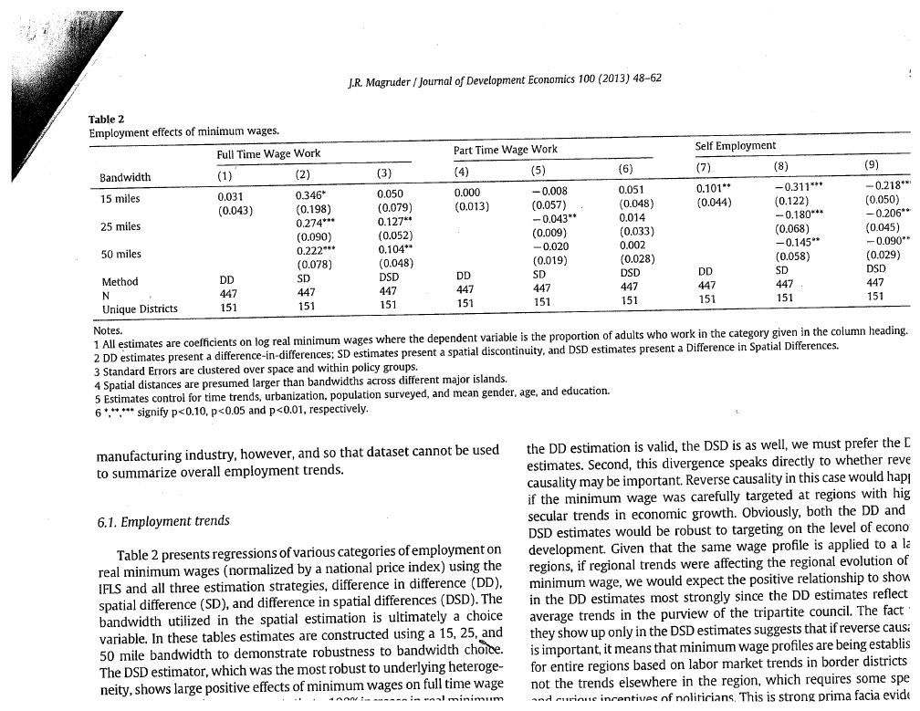
Assumes that Full time wage work would be in formal firms, part-time and self-employment more in informal sector

Slide 7
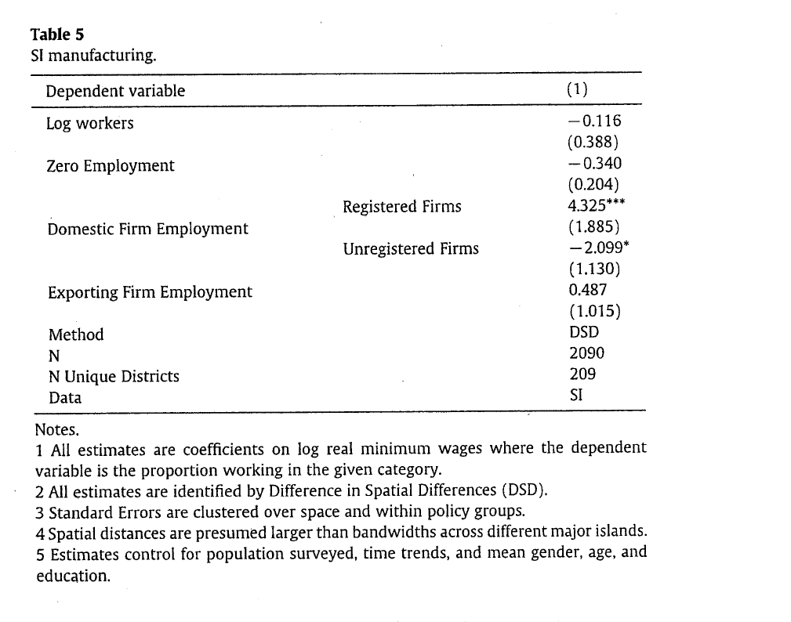
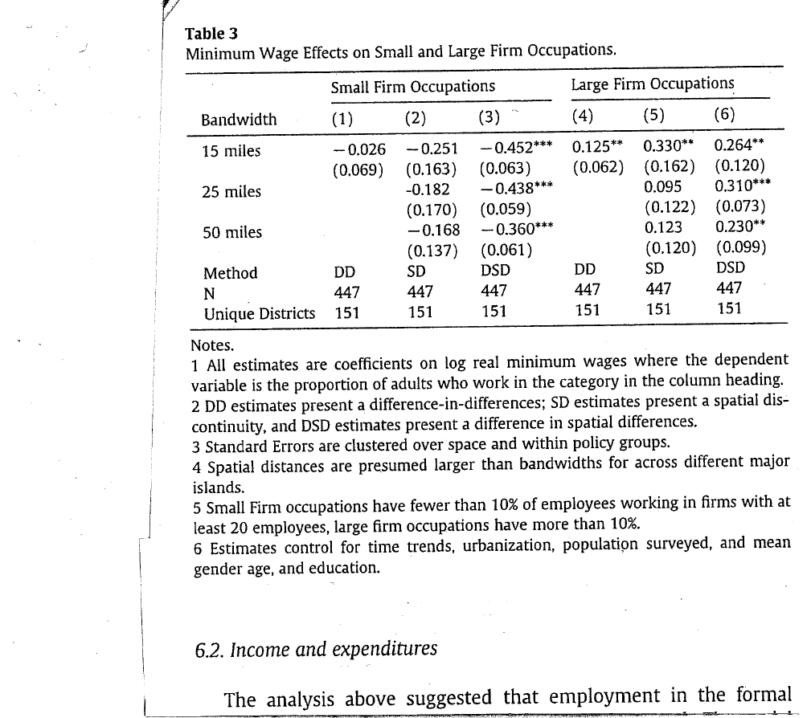

Slide 8
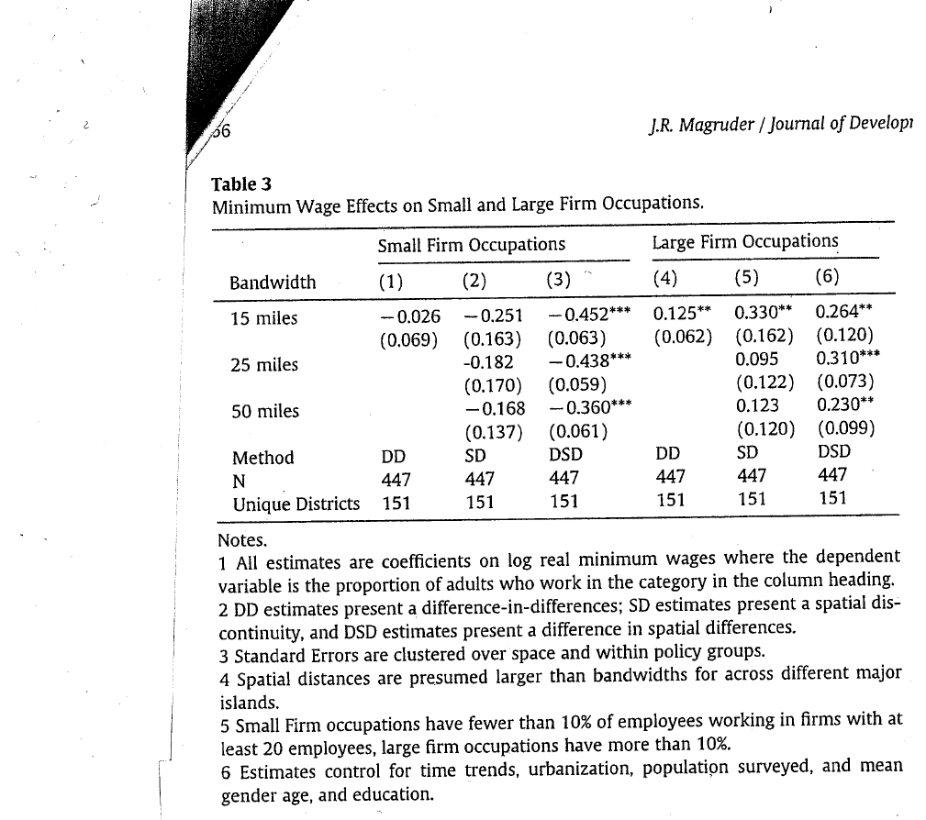

Slide 9
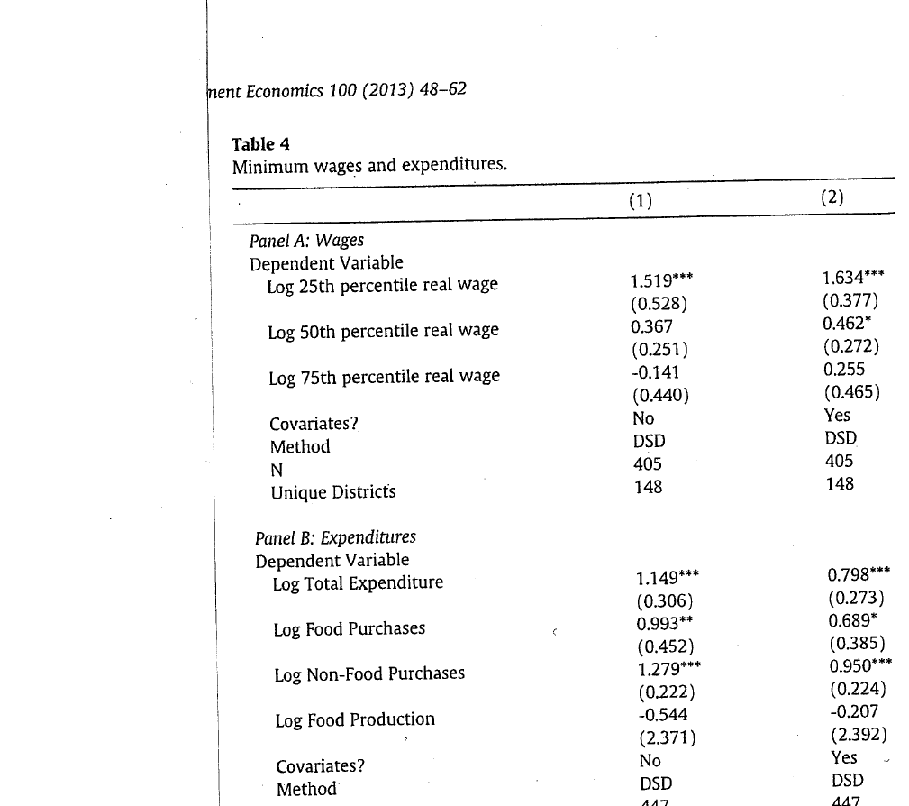

Slide 11
Other Robustness
Differences in Sectors
Positive effects in manu and services but negative in retail. Profits rise sharply in services
Reversed causality Finds no differences due to trends in wage work or border region trends
Migration. But this follow within the expaning areas there is in-migration
Monopsony as another explanation. Compute Herfindahl indexes but shows the effects are strongest in districts with low monopsony markets

Slide 12
Conclusion
In that period rising minimum wage rates helped bring about industrialization with rising productivity
Rise in formal employment relative to self employment and informal employment and more in districts with rising real minimum wages . The FDI that Indonesia was receiving may have helped provide capital and boost productivity

